Slide 1
Chapter 3 Data Analysis Library Pandas

Slide 2
Learning Objectives（1/3）​
Understand how to create Series and be able to create objects of the Series class through the Series class constructor
Understand how to create DataFrame and be able to create objects of the DataFrame class through construction methods
Be familiar with the types and characteristics of index objects and be able to summarize the types and characteristics of index objects
Master the way to reset the index . You can reset the index of the object through the reindex () method

Slide 3
Learning Objectives（2/3）​
Master the basic usage of indexes and slices , and be able to obtain data using indexes and slices
Master the basic usage of loc and iloc attributes , and be able to use loc and iloc attributes to obtain data
Master the methods of reading and writing data , and be able to skillfully read and write data from different sources
Understand how to sort data , and be able to sort a Series or DataFrame using index or value

Slide 4
Learning Objectives（3/3）​
Master arithmetic operations and be able to perform arithmetic operations on data using arithmetic operators（算术运算符） or arithmetic methods
Master the methods of statistical calculation and be able to perform statistical calculations on data through statistical methods
Master the way of statistical description and be able to describe the statistical indicators of objects through the describe() method
Master hierarchical index operations , be able to create objects with hierarchical indexes , and use hierarchical indexes to obtain data

Slide 5
Chapter Overview​
Pandas is a library based on NumPy and designed specifically for data analysis . The library not only provides some standard data models , but also provides data structures for efficiently operating large amounts of data . It is widely used in fields such as finance and statistics. The pandas library is the core of this course. This chapter only introduces some basic knowledge of pandas , and more knowledge will be introduced in later chapters.

Slide 6
Contents（1/2）​​
01
Data Structure
02
Indexing and slicing operations
03
Reading and Writing Data
04
Data Sorting

Slide 7
Contents（2/2）​​
05
Arithmetic operations and data alignment
06
Statistical calculation and description
07
Hierarchical index operations
08
Case: Statistical analysis of Shaanxi college entrance examination scores

Slide 8
3.1
Data Structure

Slide 9

3.1.1 Series
Learning objectives
Understand the structure and creation method of Series , and be able to create objects of the Series class through the constructor of the Series class

Slide 10
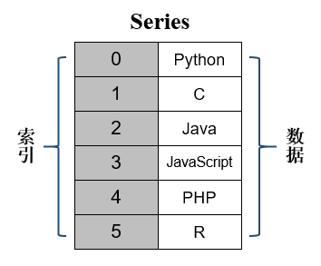
3.1.1 Series
Structure
Series is a data structure similar to a one-dimensional array, mainly consisting of a set of data and an associated index . The data can be of any type, such as integers, strings, floating-point numbers, Python objects.
The default is the index automatically generated by the system , and it can also be a user-defined index

Slide 11
3.1.1 Series
Construction method
We need to first create an object of the Series class through the Series class constructor .
Serise(data=None, index=None, dtype=None, name=None, copy=False, fastpath=False)
data : represents data , its value can be ndarray object, list, dictionary, scalar, etc.
index : represents the index , its value must be hashable and have the same length as the data. If no value is passed to the index parameter, an object of the RangeIndex class is used by default ; if the value of the data parameter is a dictionary and the value of the index parameter is None , the dictionary key is used as the index.
dtype : indicates the type of data , its value can be numpy.dtype .

Slide 12
3.1.1 Series
Creating an object of the Series class
Create an object of the Series class by passing a list to the Series class constructor .
ser_obj = pd.Series ( data=['Python', 'C', 'Java',
'JavaScript', 'PHP', 'R'] )
When creating an object of the Series class, you can also explicitly specify the label index for the data .
ser_obj = pd.Series (data=['Python', 'C', 'Java’, 'JavaScript ', 'PHP ', 'R'], index=['a', 'b', 'c', 'd', 'e', 'f'])

Slide 13
3.1.1 Series
Creating an object of the Series class
Although we can now only see the label index specified by the user, the system still generates a set of position indexes, but the position indexes are hidden .

Slide 14
3.1.1 Series
Creating an object of the Series class
You can also create an object of the Series class from a dictionary .
year_dict = {'a':2022, 'b':2023, 'c':2024,'d ':2025, 'e':2026, 'f':2027}
ser_obj = pd.Series ( data= year_dict )

Slide 15
3.1.1 Series
Get index and data
Get the index of the Series class object through the index attribute .
ser_obj.index​
Get the data of the Series class object through the values attribute .
ser_obj. values
Try demo codes on page 53-54.

Slide 16
3.1.2 DataFrame
Learning objectives
Understand the structure and creation method of DataFrame , and be able to create objects of the DataFrame class through the construction method of the DataFrame class

Slide 17
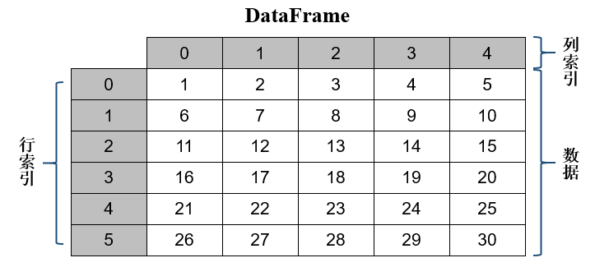
3.1.2 DataFrame
Structure
DataFrame is a data structure similar to a two-dimensional array or table. It organizes data in the form of rows and columns. Each column of data can be of different data types. Compared with Series , DataFrame also consists of two parts: index and data . The difference is that DataFrame has both row index and column index .
DataFrame can be viewed as a combination of multiple Series class objects. Each column of data in it is an object of the Series class, and these objects share the same row index.

Slide 18
3.1.2 DataFrame
Construction method
We need to first create an object of the DataFrame class through the DataFrame class constructor .
DataFrame(data=None, index=None, columns=None,dtype =None, copy=None)
data : represents data . This parameter can receive ndarray objects, lists, dictionaries, or other DataFrame class objects.
index : indicates the row index . If this parameter is not passed, an integer from 0 to N will be automatically generated by default .
columns : represents the column index . If no index parameter is passed, an integer from 0 to N is automatically generated by default .

Slide 19
3.1.2 DataFrame
Creating DataFrame Class Objects
import numpy as np
import pandas as pd
arr_2d = np.arange (1, 31).reshape((6, 5 ))
df_obj = pd.DataFrame (data=arr_2d )
df_obj
Use the index automatically generated by the system

Slide 20
3.1.2 DataFrame
Specifying column indexes
The system cannot well display the meaning of each column of data, making the data less readable. Therefore, we can specify row indexes or column indexes for the data to improve the display effect of the data.
df_obj = pd.DataFrame (data=arr_2d,
columns =['No1', 'No2', 'No3 ', 'No4', 'No5 '] )
df_obj

Slide 21
3.1.2 DataFrame
Get a column of data
If you want to get a column of data from an object of the DataFrame class, you can get it by accessing the attributes , and the returned result is an object of the Series class.
result = df_obj.No2
result
※ If there are some special characters in the index label name, such as spaces, underscores, etc., it is not appropriate to obtain data by accessing attributes. In this case, you can use the index to obtain data .

Slide 22
3.1.2 DataFrame
View summary information
In order to help users understand the summary information of the data, such as the total number of data in each column, the type of data in each column, which column is missing data, etc., you can use the info() method to view it.
<class ' pandas.core.frame.DataFrame '>
RangeIndex: 6 entries, 0 to 5
Data columns (total 5 columns):
# Column Non-Null Count Dtype
--- ------ -------------- -----
0 No1 6 non-null int32
1 No2 6 non-null int32
2 No3 6 non-null int32
3 No4 6 non-null int32
4 No5 6 non-null int32
dtypes: int32(5)
memory usage: 248.0 bytes
df_obj.info()

Slide 23
3.1.2 DataFrame
View summary information
<class 'pandas.core.frame.DataFrame'>
RangeIndex: 6 entries, 0 to 5
Data columns (total 5 columns):
# Column Non-Null Count Dtype
--- ------ -------------- -----
0 No1 6 non-null int32
1 No2 6 non-null int32
2 No3 6 non-null int32
3 No4 6 non-null int32
4 No5 6 non-null int32
dtypes: int32(5)
memory usage: 248.0 bytes
The type of object , information about the row index , and the total number

Slide 24
3.1.2 DataFrame
View summary information
<class 'pandas.core.frame.DataFrame'>
RangeIndex: 6 entries, 0 to 5
Data columns (total 5 columns):
# Column Non-Null Count Dtype
--- ------ -------------- -----
0 No1 6 non-null int32
1 No2 6 non-null int32
2 No3 6 non-null int32
3 No4 6 non-null int32
4 No5 6 non-null int32
dtypes: int32(5)
memory usage: 248.0 bytes
5 rows and 4 columns, used to describe the specific information of each column of data of the object

Slide 25
3.1.2 DataFrame
View summary information
<class 'pandas.core.frame.DataFrame'>
RangeIndex: 6 entries, 0 to 5
Data columns (total 5 columns):
# Column Non-Null Count Dtype
--- ------ -------------- -----
0 No1 6 non-null int32
1 No2 6 non-null int32
2 No3 6 non-null int32
3 No4 6 non-null int32
4 No5 6 non-null int32
dtypes: int32(5)
memory usage: 248.0 bytes
Statistics and memory usage of data types
Try demo codes on page 55-57.

Slide 26
Indexing and slicing operations
3.2

Slide 27
3.2.1 Index Object
Learning objectives
Be familiar with the types and characteristics of index objects and be able to summarize the types and characteristics of index objects

Slide 28
3.2.1 Index Object
Subclasses
In pandas , whether it is a position index or a label index, they all belong to the object of the Index class , that is, the index object. The Index class is a base class, which derives（派生） many subclasses , each of which represents a different form of index.
kind | illustrate | Example
RangeIndex | Position index (default) | 0 , 1 , 2 , 3 , ... N
Int64Index | Integer index | 1 , -5 , 8 , 10 , -9
Float64Index | Floating point index | -1.0 , -5.5 , 10.2 , 9.8 , 6.3
DatetimeIndex | Timestamp Index | 2022-11-25 17:00:00 , 2022-11-28 17:00:00 , 2022-12-25 17:00:00
PeriodIndex | Time interval index | 2022-11-25 00:00:00 , 2022-11-25 01:00:00 , 2022-11-25 02:00 : 00…
MultiIndex | Hierarchical Indexing | a a , ab , ac , bd , be

Slide 29

3.2.1 Index Object
Characteristic
Immutability
不可变性
Repeatability
可重复性

Slide 30
3.2.1 Index Object
Once an index object is created, it cannot be modified . In other words, the value of the index is fixed. This maintains the unique mapping relationship from index to data and ensures the security of data in Series or DataFrame.
Characteristic
import pandas as pd
ser_obj = pd.Series (range(5),
index =['a', 'b', 'c', 'd', 'e'])
ser_index ['2'] = 'cc'
Immutability
不可变性
TypeError: Index does not support mutable（可变）operations

Slide 31
3.2.1 Index Object
Characteristic
Index object values can be repeated .
import pandas as pd
ser_obj = pd.Series (range(5),
index =[ 'a', 'a' , 'c', 'd', 'e'])
ser_index = ser_obj.index
ser_index
Repeatability
可重复性

Slide 32
3.2.1 Index Object
Characteristic
Normally, index values are required to be unique, but this is not mandatory. We can use the is_unique attribute of the index object to determine whether the index value is unique .
Repeatability
可重复性
ser_index.is_unique​
Try demo codes on page 58.

Slide 33
3.2.2 Reset Index
Learning objectives
Understand how to reset the index and be able to use the reindex () method to reset the index

Slide 34

3.2.2 Reset Index
Concept
Reindexing means re-indexing an object to build an object that conforms to the new index.
Method
reindex () method matches the original index and new index of the Series or DataFrame object. If the value of the new index is the same as the original index, the data corresponding to the new index will be set to the original data; if the value of the new index is different from the original index, the vacant position corresponding to the new index will be filled with NaN or other specified values.

Slide 35
3.2.2 Reset Index
Syntax
The following takes the reindex () method of the DataFrame class as an example to introduce the syntax format of the reindex () method .
reindex (labels=None, index=None, columns=None, axis=None,
method=None , copy=True, level=None, fill_value =nan,
limit=None , tolerance=None)
index , columns : represents the new row index and column index .
method : indicates how to fill the empty positions , including 'None' (default value), ' ffill ' or 'pad' , ' bfill or backfill' , and 'nearest' . 'None' means not to fill the empty positions; ' ffill ' or 'pad' means to fill the empty positions forward; ' bfill or backfill' means to fill the empty positions backward; 'nearest' means to fill the empty positions according to the nearest value.
copy : Whether to return a new object , the default value is True .
fill_value : indicates the value to fill the empty position , the default value is NaN .
limit : indicates the maximum filling amount when filling forward or backward .

Slide 36
3.2.2 Reset Index
Example
1. Reset the index of a DataFrame
import pandas as pd
df_obj = pd.DataFrame ({'no1': [1.0, 2.0, 3.0],
'no2': [4.0, 5.0, 6.0]},
index=['a', 'b', 'c '])
new_df = df_obj.reindex (index=['a', ' c', 'e'])
new_df

Slide 37
3.2.2 Reset Index
Example
2. Specify fill value when resetting the index
import pandas as pd
df_obj = pd.DataFrame ({'no1': [1.0, 2.0, 3.0],
'no2': [4.0, 5.0, 6.0]},
index=['a', 'b', 'c'])
new_df = df_obj.reindex (index=['a', 'c', 'e'],
fill_value =9 )
new_df

Slide 38
3.2.2 Reset Index
Example
3. Specify the fill method when resetting the index
import pandas as pd
df_obj = pd.DataFrame ({'no1': [1.0, 2.0, 3.0],
'no2': [4.0, 5.0, 6.0]},
index=['a', 'b', 'c'])
new_df = df_obj.reindex (index=['a', 'c', 'e'],
method = ' ffill ' )
new_df
Try demo codes on page 59-60.

Slide 39
3.2.3 Retrieving data
Learning objectives
Master the basic usage of indexing and slicing , and be able to obtain Series or DataFrame data through indexing or slicing

Slide 40

3.2.3 Retrieving data
In pandas , you can get the data of Series and DataFrame objects through indexing or slicing . Since the structures of Series and DataFrame objects are different, their indexing and slicing operations are also different.

Slide 41
3.2.3 Retrieving data
Series indexing and slicing
Series class objects is similar to that of NumPy one-dimensional arrays, except that the index of Series class objects can be either positional index or label index. If you need to get a single data of a Series class object , you can get it by positional index or label index .
import pandas as pd
ser_obj = pd.Series ([10, 20, 30, 40, 50],
index=['one', 'two', 'three', 'four', 'five'])
ser_obj[2]
Get a single data by position index
Get a single data by label index
ser_obj['three']

Slide 42
3.2.3 Retrieving data
Series indexing and slicing
If you want to get multiple data of the Series class object, you can get it through a list containing multiple position indexes or label indexes . This process is equivalent to using fancy indexing to get one-dimensional array elements .
Get multiple data
ser_obj [ [0, 2, 3] ]
ser_obj [ ['one', 'three', 'four'] ]
Get multiple data

Slide 43
3.2.3 Retrieving data
Series indexing and slicing
Boolean indexing is also applicable to pandas . The specific usage is the same as that of boolean indexing for one-dimensional arrays, that is, to perform logical operations on each data in the Series class object . As long as the operation result is True , the data corresponding to the position of True in the Series class object is returned .
ser_obj [ ser_obj > 20]

Slide 44
3.2.3 Retrieving data
Series indexing and slicing
Slicing can also be used to obtain partial data from a Series object . If the index used for slicing is a position index , the slice result contains the data corresponding to the starting position but not the ending position ; if the index used for slicing is a label index , the slice result contains the data corresponding to both the starting position and the ending position .
Slicing operations
ser_obj [1:3]
ser_obj [' two':'four ']
Slicing operations by label index

Slide 45
3.2.3 Retrieving data
DataFrame indexing and slicing operations
DataFrame class object is similar to the index usage of the NumPy two-dimensional array. Each column of data in it is an object of the Series class and can be obtained through the column index .
import numpy as np
import pandas as pd
arr = np.arange (12).reshape(3, 4)
df_obj = pd.DataFrame ( arr , index=['row_1', 'row_2',
'row_3 '], columns =['col_1', 'col_2', 'col_3', 'col_4'])
df_obj ['col_2']

Slide 46
3.2.3 Retrieving data
DataFrame indexing and slicing operations
If you want to get multiple columns of data from a DataFrame class object, you can store multiple indexes in a list and then get them based on each index in the list . This process is equivalent to using fancy indexing to get two-dimensional array elements.
df_obj [['col_1', 'col_3']]

Slide 47
3.2.3 Retrieving data
DataFrame indexing and slicing operations
If you want to get multiple rows of data from a DataFrame class object , you can do it through slicing.
df_obj [1:3]
You can also use slicing to get data from some rows and columns .
df_obj [1:3][['col_1', 'col_3']]
Try demo codes on page 60-62.

Slide 48
3.2.4 Get data through loc and iloc attributes
Learning objectives
Master the basic usage of loc and iloc attributes , and be able to use loc and iloc attributes to obtain Series or DataFrame data

Slide 49
3.2.4 Get data through loc and iloc attributes
When we introduced the operations related to indexing and slicing, we said that we can use positional indexing or label indexing alone to get data, or we can use a combination of positional indexing and label indexing. This is very confusing for developers who are new to pandas . In order to strictly distinguish between positional indexing and label indexing operations , pandas provides two very important attributes, loc and iloc . loc is an indexer based on label indexing. iloc is a position-based indexer .

Slide 50
3.2.4 Get data through loc and iloc attributes
Retrieve data through the loc attribute
loc attribute is used to get data based on the label index .
Series.loc [ parameters ]
DataFrame.loc [ parameter 1, parameter 2]
Single label index , such as a , No1 , row_1 , col_1 , etc.
A list or array of label indices , such as ['a' , 'b' , 'c'] , ['col_1', 'col_3'] , etc.
Slices based on label indices , such as 'a': 'c' , ' two':'four ' .
A list or array of boolean values , such as [True, False, True ] .
※ The indexes involved in parameter 1 and parameter 2 are row index and column index respectively. If parameter 2 is omitted , the result obtained is one or more rows of data of the DataFrame class object.

Slide 51
3.2.4 Get data through loc and iloc attributes
Retrieve data through the loc attribute
1. Retrieve data for Series class objects
import pandas as pd
ser_obj = pd.Series ([10, 20, 30, 40, 50],
index =['row1', 'row2', 'row3', 'row4', 'row5 '])
Get a single data
Get multiple data
ser_obj.loc [ 'row2' ]
ser_obj.loc [ ['row2', 'row5'] ]
ser_obj.loc [
'row3 ':'row5' ]
Get multiple
Continuous Data
ser_bool = ser_obj < 30
ser_obj.loc[ ser_bool ]
Get data that meets the criteria

Slide 52
3.2.4 Get data through loc and iloc attributes
Retrieve data through the loc attribute
2. Retrieve data for DataFrame class objects
arr = np.arange (12).reshape(3, 4)
df_obj = pd.DataFrame ( arr , index=['row_1', 'row_2', 'row_3'],
columns =['col_1', 'col_2', 'col_3', 'col_4 '])
Get a row of data
Get multiple rows of data
df_obj.loc [ 'row_1' ]
df_obj.loc [ ['row_1', 'row_3'] ]
df_obj.loc [ 'row_1':'row_2' ]
Get multiple consecutive rows of data
Get multiple rows of data that meet the conditions
df_obj.loc [ [True, False, True] ]

Slide 53
3.2.4 Get data through loc and iloc attributes
Retrieve data through the loc attribute
2. Get the data
arr = np.arange (12).reshape(3, 4)
df_obj = pd.DataFrame ( arr , index=['row_1', 'row_2', 'row_3'],
columns =['col_1', 'col_2', 'col_3', 'col_4 '])
df_obj.loc [ 'row_3', 'col_3' ]
Get a single data
df_obj.loc [ 'row_1':'row_3', ['col_1', 'col_3'] ]
Get multiple columns of data

Slide 54
3.2.4 Get data through loc and iloc attributes
Get data
Retrieve data through the iloc attribute
iloc attribute is used to obtain data based on the position index .
Series.iloc [ parameters ]
DataFrame.iloc [ parameter 1, parameter 2]
A single position index , such as 0 , 1 , 2 , 3 , etc.
A list or array of position indices , such as [0 , 2 , 3] , etc.
Slices based on positional indexes , such as 0:2 , 2:5 .
A list or array of boolean values , such as [True, False, True ] .

Slide 55
3.2.4 Get data through loc and iloc attributes
Retrieve data through the iloc attribute
Get a row of data
Get multiple rows of data
df_obj.iloc [ 0 ]
df_obj.iloc [ [0, 2] ]
Get continuous
Multiple rows of data
Get multiple rows of data that meet the conditions
df_obj.iloc [ 0:2 ]
df_obj.iloc [ [True, False, True] ]
Get a single
data
Get more
Column Data
df_obj.iloc [ 2, 2 ]
df_obj.iloc [ 0:3, [0, 2] ]
Try demo codes on page 63-65.

Slide 56
3.3
Reading and Writing Data

Slide 57
3.3.1 Read and write data from CSV and TXT files
Learning objectives
Master the methods of reading and writing data, and be able to skillfully read and write data in

Slide 58

3.3.1 Read and write data from CSV and TXT files
CSV and TXT files are plain text files commonly used in daily life. They can only save the content of the text but not the style of the text. CSV files usually use commas or tabs as delimiters（分隔符） and can be viewed through text editors such as Excel and Notepad .

Slide 59
3.3.1 Read and write data from CSV and TXT files
Pandas provides a read_csv () function , which is used to read data from a CSV or TXT file. Pandas ' Series and DataFrame classes also provide a to_csv () method , which is used to write data to a CSV or TXT file .

Slide 60
3.3.1 Read and write data from CSV and TXT files
Write data to a text file using the to_csv() method
to_csv () method writes part or all of the data to a CSV or TXT file in the specified path . If the file does not exist, a new file will be created; if the file already exists, the contents of the file will be overwritten.
to_csv( path_or_buf =None, sep =',', na_rep ='', float_format =None, columns=None, header=True, ..., storage_options =None)
path_or_buf : indicates the file path , which can be an absolute path or a relative path. If the value of this parameter is a file name, the file will be saved to the current path.
sep : indicates the field separator used by the file , the default value is ',' . The length of the separator must be 1 .
na_rep : Indicates how missing data is represented . The default value is an empty string .
columns : Indicates which columns of data are written to the file .
header : indicates the column header displayed in the file .
index : Indicates whether to write the line index to the file . The default value is True .

Slide 61
3.3.1 Read and write data from CSV and TXT files
Read data from a text file using the read_csv() function
read_csv () function reads data from a CSV or TXT file in the specified path . After successful reading, it converts the data into an object of the Series or DataFrame class according to the data format.
read_csv( filepath_or_buffer , sep = NoDefault.no_default , delimiter=None, header='infer', ..., storage_options =None)
filepath_or_buffer : indicates the path of the file .
sep : Indicates the separator used by the file . If no separator is specified, a comma will be tried for separation.
header : Specifies which line in the file is the beginning of the column indices and data .
names : A list indicating the column names to use .
encoding : Indicates the encoding format used when reading the file .

Slide 62
3.3.1 Read and write data from CSV and TXT files
Read data from a text file using the read_csv() function
In addition to using the read_csv() function to read TXT files, you can also use the read_table () function to read TXT files. The difference between the two is that the default delimiter used is different. The delimiter used by the former is a comma, and the delimiter used by the latter is a tab character ( \t ) .

Slide 63


3.3.1 Read and write data from CSV and TXT files
Learn one more trick : preview some data
After reading data from a file, if you want to know whether the data is actually read successfully, you can select a few lines of data for quick preview. Pandas provides two commonly used methods , head() and tail() . The head() method is used to preview the first N lines of data , the default is the first 5 lines of data; the tail() method is used to preview the last N lines of data , the default is the last 5 lines of data.
Try demo codes on page 66-69.

Slide 64
3.3.2 Read and write data from Excel files
Learning objectives
Master the methods of reading and writing data, and be able to skillfully read and write data in Excel files

Slide 65

3.3.2 Read and write data from Excel files
Excel files are commonly used files for storing data in data analysis work. Several worksheets can be added to it . Each worksheet displays data in the form of a table and supports statistics, analysis and other operations on the data.

Slide 66
3.3.2 Read and write data from Excel files
Pandas provides the functions of reading and writing Excel file data, namely the to_excel () method and the read_excel () function . The to_excel () method is used to write data to Excel files, and the read_excel () function is used to read data from Excel files.

Slide 67
3.3.2 Read and write data from Excel files
Write data to Excel file via to_excel ()
to_excel () method writes objects of the Series or DataFrame class into an Excel file . If the Excel file does not exist, a new file will be created, otherwise the contents of the original file will be overwritten.
to_excel ( excel_writer , sheet_name ='Sheet1', na_rep ='', float_format =None, columns=None, header=True, ..., storage_options =None)
excel_writer : indicates the path to the file being written .
sheet_name : represents the name of the worksheet , which can accept a string. The default value is " Sheet1 ".
na_rep : Representation of missing data .
index : Indicates whether to write the line index to the file , the default is True .

Slide 68
3.3.2 Read and write data from Excel files
Read data from Excel files with read_excel ()
read_excel () function is used to read data from an Excel file and convert it into an object of the Series or DataFrame class according to the format of the data .
read_excel ( io , sheet_name =0, header=0, names=None, index_col =None, usecols =None , squeeze=None, dtype =None, ..., storage_options =None)
io : indicates the path of the file .
sheet_name : Specifies the name of the worksheet to be read . The default value is 0 , indicating that the first worksheet is read.
header : Specifies which row of data in the file is used as the column index of the DataFrame class object .
names : Indicates the column names to use .
index_col : Specifies which column of data in the file is used as the row index of the DataFrame .
usecols : specifies which columns of data to read . The default value is None , indicating that all columns of data will be read. This parameter can receive a list, and the elements in the list correspond to the column numbers, starting from 0 .
Try demo codes on page 70-72.

Slide 69
3.3.3 Read data from a webpage table
Learning objectives
Master the method of reading web tables and be able to skillfully read data from web tables

Slide 70
3.3.3 Read data from a webpage table
When browsing the web, some data will be displayed in the form of a table in the HTML web page. For this part of the data, we can use the read_html () function in pandas to read it. After successful reading, a list will be returned, which contains objects of the DataFrame class corresponding to the web page table .
read_html ( io , match='.+', flavor=None, header=None, index_col =None, skiprows =None, attrs =None, ..., displayed_only = True)
io : A string , path object, or file-like object representing an HTML webpage . If the value of the parameter io is a string, the content of the string can be a URL or HTML .
match : Returns a table containing text that matches the regular expression or string . The default value is '.+' , which means it matches any non-empty string.
header : Used to specify the row where the column header is located .
index_col : Used to specify the column where the row header is located .

Slide 71
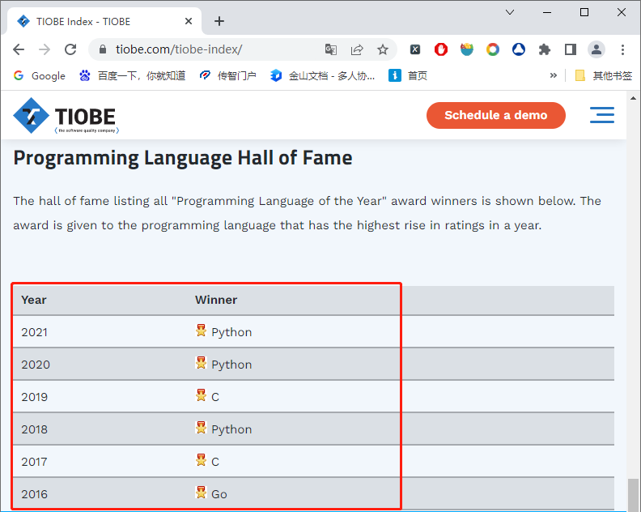
3.3.3 Read data from a webpage table
TIOBE ranking is based on the number of experienced programmers, courses, and third-party vendors on the Internet, and uses search engines to compile ranking data to reflect the popularity of programming languages.
Ranking of the best programming languages of the year released in 2022 (partial)
Try demo codes on page 73.

Slide 72
3.3.4 Read and write database
Learning objectives
Master the methods of reading and writing databases , and be able to skillfully read and write database data

Slide 73

3.3.4 Read and write database
In most cases, massive amounts of data are stored in databases, which mainly relies on the database's data sharing, independence and other characteristics. Therefore, in actual production environments, most data is stored in databases. Pandas supports read and write operations on mainstream databases such as MySQL , Oracle , and SQLite . This book introduces the MySQL database .

Slide 74
3.3.4 Read and write database
Read and write functions or methods
Functions / Methods | Illustrate
read_sql_table() | Read the database data according to the data table name , and convert the read result into an object of the DataFrame class and return it
read_sql_query() | Read the database data according to the SQL statement , and convert the read result into an object of the DataFrame class and return it
read_sql() | The combination of the above two functions can read the database data according to the data table name or SQL statement
to_sql() | Write objects of the Series or DataFrame class to the database
※ Both the read_sql_table () and read_sql_query () functions can convert the read data into DataFrame objects. The former means converting the data of the entire table into an object of the DataFrame class, while the latter means converting the result of executing the SQL statement into an object of the DataFrame class.

Slide 75
3.3.4 Read and write database
Read and write functions or methods
When connecting to a MySQL database, you need to use the SQLAlchemy and PyMySQL modules. The SQLAlchemy module provides the function of connecting to different databases , while the PyMySQL module provides the function of operating the MySQL database in Python . If these two modules are not available in the current Python environment, you need to use the " pip install sqlalchemy ==1.4.39 " and " pip install pymysql ==1.0.2 " commands to install these modules respectively.

Slide 76
3.3.4 Read and write database
Write data to the database through the to_sql () method
to_sql () method is to write objects of the Series class or DataFrame class into the database in the form of a data table .
to_sql ( name , con , schema = None , if_exists = 'fail' , index = True ,
index_label = None , chunksize = None , dtype = None ）
name : indicates the name of the data table .
con : indicates the connection information of the database . The value of this parameter can be an object of the Engine class or the Connection class. If you want to create an object of the Engine class, you need to use the create_engine () function, which needs to receive a string that meets the format requirements. The specific format is "database type + database driver name :// user name : password @ machine address : port number / database name" .
if_exists : How to operate the data table when the data table exists . The parameter can be set to fail , replace , or append . The default value is fail . Fail means not to perform the write operation; replace means to delete the original data table and then recreate it; append means to append data based on the original data table.
index : Indicates whether to pass the row index of DataFrame as data to the database . The default value is True .
index_label : Indicates whether to reference the index name . If index is set to True , this parameter is None , indicating that the default name is used; if index is a hierarchical index, its value must be a sequence type.

Slide 77
3.3.4 Read and write database
Write data to the database through the to_sql () method
using the to_sql () method to write data to the database, if the name of the data table to be written is the same as the name of another data table in the database , the program will cause an exception and feedback the exception information that the data table already exists.

Slide 78
3.3.4 Read and write database
Read data from the database through the read_sql () function
read_sql () function can both read the entire data table and execute SQL statements .
read_sql ( sql , con, index_col =None, coerce_float =True, params =None,
parse_dates =None, columns=None, chunksize =None)
sql : represents the SQL statement to be executed .
con : Receive database connection, indicating the database connection information .
index_col : Indicates that the column headers in the data table are used as the row index of the DataFrame class object.
coerce_float : Converts the value of a non-string or non-numeric object to floating-point data .
params : A list of parameters passed to the execution method , such as params = {' name':'value '} .
※ If there are null values in the data, NaN will be used to fill it.
Try demo codes on page 75-76.

Slide 79
3.4
Data Sorting

Slide 80
3.4.1 Sort
Learning objectives
Master the method of sorting by index, and be able to sort by row index or column index using the sort_index() method

Slide 81
3.4.1 Sort by index
The sort_index () method can sort Series and DataFrame objects according to the size of their row or column indices .
sort_index(axis=0, level=None, ascending=True, inplace =False,
kind ='quicksort', na_position ='last', sort_remaining =True,
ignore_index =False , key=None)
axis : indicates the axis along which to sort . The value of this parameter can be 0 or 'index' , 1 or 'columns' , where 0 or 'index' indicates sorting in the row direction, and 1 or 'columns' indicates sorting in the column direction.
ascending : Indicates whether to sort in ascending order . The default value is True .
kind : indicates the sorting algorithm , which can be 'quicksort', ' mergesort ', 'heapsort', 'stable' , where 'quicksort' indicates the quick sorting algorithm, ' mergesort ' indicates the merge sorting algorithm, 'heapsort' indicates the heap sorting algorithm, and 'stable' indicates the stable sorting algorithm.

Slide 82
3.4.2 Sort by value
Learning objectives
Master the way to sort by value , and be able to sort by value using the sort_values () method

Slide 83
3.4.2 Sort by value
Pandas provides a method sort_values () for objects of the Series and DataFrame classes to sort by value . Taking the method of the DataFrame class as an example, the syntax format of the sort_values () method is as follows.
sort_values (by, axis=0, ascending=True, inplace =False, kind ='quicksort', na_position ='last', ignore_index =False, key=None)
by : indicates the column to sort by .
na_position : Indicates the position of the NaN value . It has only two possible values: first and last . The default value is last . If it is set to first , the NaN value will be placed at the beginning; if it is set to False , the NaN value will be placed at the end.

Slide 84
3.4.2 Sort by value
If the object operated by the sort_values () method is an object of the DataFrame class, it can be sorted according to the values of one or more columns in the object, but the index of one or more columns needs to be passed to the by parameter .
df_obj = pd.DataFrame ([[0.4, -0.1, -0.3, 0.0],
[ 0.2, 0.6, -0.1, -0.7],
[ 0.8, 0.6, -0.5, 0.1]])
df_obj.sort_values ( by=2 )
Try demo codes on page 77-79.

Slide 85
Arithmetic operations and data alignment
3.5

Slide 86
3.5 Arithmetic operations and data alignment
Learning objectives
Master arithmetic operations and be able to perform arithmetic operations through arithmetic operators or arithmetic methods

Slide 87
3.5 Arithmetic operations and data alignment
In pandas , when performing arithmetic operations on objects of the Series or DataFrame class, the data with the same index will be aligned first , and then the corresponding operations will be performed . The unaligned positions will be filled with NaN .
obj_one = pd.Series (range(10,13 ),
index=range(3))
obj_one
obj_two = pd.Series (range(20, 25), index=range(5))
obj_two
obj_one + obj_two
0 10
1 11
2 12
dtype : int64
0 20
1 21
2 22
3 23
4 24
dtype : int32
0 30.0
1 32.0
2 34.0
3 NaN
4 NaN
dtype : float64

Slide 88
3.5 Arithmetic operations and data alignment
If you do not want to use NAN padding, you can pass a value to the fill_value parameter when calling the add() method , and fill_value will be padded with the data existing in the object .
obj_one.add ( obj_two , fill_value =0 )
Try demo codes on page 79-80.

Slide 89
Statistical calculation and description
3.6

Slide 90
3.6.1 Statistical computing
Learning objectives
Master the methods of statistical calculation and be able to perform statistical calculations on the data in the DataFrame through statistical methods

Slide 91
3.6.1 Statistical computing
Statistical calculation methods（1/2）
method | illustrate
sum() | Calculation and
mean() | Calculate the average
median() | Calculating the median
max() , min() | Calculate the maximum and minimum values
idxmax () | Calculate the maximum index value
idxmin () | Calculate the minimum index value
count() | Count the number of non- NaN values

Slide 92
3.6.1 Statistical computing
Statistical calculation methods（2/2）
method | illustrate
var () | the variance of sample values
std () | the standard deviation of sample values
skew() | Calculate the skewness (third moment) of the sample values
kurt () | Calculates the kurtosis (fourth-order moment) of the sample values
cumsum () | the cumulative sum
cummin () , cummax () | the cumulative minimum and cumulative maximum of sample values
cumprod () | cumulative product

Slide 93
3.6.2 Statistical description
Learning objectives
Master the way of statistical description and be able to describe the statistical indicators of the object of the DataFrame class through the describe() method

Slide 94
3.6.2 Statistical description
If we want to describe multiple statistical indicators of Series or DataFrame objects at one time , such as the average, maximum, minimum, sum, etc., we can call the describe() method to achieve it instead of calling each statistical calculation method one by one.
describe(percentiles=None, include=None, exclude=None)
percentiles : indicates the percentage contained in the result , between [0,1] . If this parameter is not set, the default is [0.25,0.5,0.75] , which means that the 25% , 50% , and 75% quantiles are displayed.
include : indicates a whitelist of data types to be included in the result . The default value is None .
exclude : Indicates a blacklist of data types to be ignored in the result . The default value is None .
Try demo codes on page 81-82.

Slide 95
Hierarchical index operations
3.7

Slide 96
3.7.1 Creating a Hierarchical Index
Learning objectives
Understand how to create hierarchical indexes and be able to create hierarchical indexes in multiple ways

Slide 97
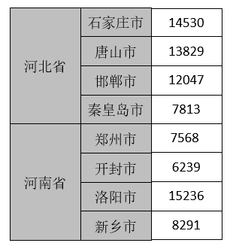
3.7.1 Creating a Hierarchical Index
Hierarchical Indexing
A hierarchical index can be understood as an extension of a single-level index, that is, an index with two or more levels in one axis.
Outer Index
Inner index

Slide 98
3.7.1 Creating a Hierarchical Index
How to create a hierarchical index
In pandas , a hierarchical index is actually a MultiIndex class object. The class provides some methods for creating hierarchical indexes .
from_tuples()
from_arrays()
from_product()
Creates an object of MultiIndex class from the Cartesian product（笛卡尔乘积） of multiple collections .
Create an object of MultiIndex class from a list of tuples .
Create an object of MultiIndex class from a nested list .

Slide 99
3.7.1 Creating a Hierarchical Index
How to create a hierarchical index
1. Create an object of the MultiIndex class through the from_tuples() method
from_tuples() method can create an object of the MultiIndex class from a list containing several tuples , where the first element of the tuple is used as the outer index and the second element of the tuple is used as the inner index .
from pandas import MultiIndex
list_tuples = [('A','A1'), ('A','A2'), ('B','B1'),
( 'B','B2'), ('B','B3')]
multi_index = MultiIndex. from_tuples (tuples= list_tuples ,
names = [' Outer index ', ' Inner index '])
multi_index

Slide 100
3.7.1 Creating a Hierarchical Index
How to create a hierarchical index
2. Create an object of the MultiIndex class through the from_arrays() method
from_arrays() method is used to create an object of the MultiIndex class based on a nested list, where the first nested list will be used as the outer index and the second nested list will be used as the inner index .
from pandas import MultiIndex
multi_array = MultiIndex. from_arrays (arrays =
[[ 'A', 'B', 'A', 'B', 'B'],
['A1', 'A2', 'B1', 'B2', 'B3']],
names=[' Outer index ', ' Inner index '])
multi_array

Slide 101
3.7.1 Creating a Hierarchical Index
How to create a hierarchical index
3. Create an object of the MultiIndex class through the from_product() method
from_product() method is used to create an object of MultiIndex class from the Cartesian product of multiple collections .
from pandas import MultiIndex
import pandas as pd
numbers = [0, 1, 2]
colors = ['green', 'purple']
multi_product = pd.MultiIndex. from_product (
iterables =[numbers, colors], names =['number', 'color'])
multi_product

Slide 102
3.7.1 Creating a Hierarchical Index
Learn one more trick : Cartesian product
In mathematics, the Cartesian product of two sets X and Y , also called the direct product , is expressed as X × Y , where the first object is a member of X and the second object is a member of all possible ordered pairs of Y. .

Slide 103
3.7.1 Creating a Hierarchical Index
Learn one more trick : Cartesian product
Assume set A={a, b} and set B={0, 1, 2} , then the Cartesian product of the two sets is {(a, 0), (a, 1), (a, 2), (b, 0), (b, 1), (b, 2)} .
0 1 2
B
A
a b
(a,0)
(a,1)
(a,2)
(b,0)
(b,1)
(b,2)
A×B
Try demo codes on page 83-84.

Slide 104
3.7.2 Creating objects with hierarchical indexes
Learning objectives
Understand how to create hierarchical index objects . You can create hierarchical index objects in two ways.

Slide 105
3.7.2 Creating objects with hierarchical indexes
Common methods
If you want Series and DataFrame objects to have a hierarchical index, the most common way is to pass a nested list in the index argument of the Series and DataFrame constructors .
Create an object of the Series class with a hierarchical index
import numpy as np
import pandas as pd
mulitindex_series = pd.Series ([ 14530, 13829, 12047, 7813 , 7568,
6239, 15236, 8291],
index =[[' Hebei Province ',' Hebei Province ',' Hebei Province ',' Hebei Province ',' Henan Province ',' Henan Province ',
' Henan Province ',' Henan Province '],
[' Shijiazhuang City ', ' Tangshan City ', ' Handan City ', ' Qinhuangdao City ', ' Zhengzhou City ',
' Kaifeng ', ' Luoyang ', ' Xinxiang ']] )
mulitindex_series

Slide 106
3.7.2 Creating objects with hierarchical indexes
Common methods
If you want Series and DataFrame objects to have a hierarchical index, the most common way is to pass a nested list to the index argument of the Series and DataFrame constructors .
Create a DataFrame object
import pandas as pd
from pandas import DataFrame , Series
mulitindex_df = DataFrame ({' Area ':[14530, 13829, 12047, 7813,
7568 , 6239 , 15236 , 8291]},
index =[[' Hebei Province ',' Hebei Province ',' Hebei Province ',' Hebei Province ', ' Henan Province ',' Henan Province ',
' Henan Province ',' Henan Province '], [' Shijiazhuang City ',' Tangshan City ',' Handan City ',' Qinhuangdao City ',
' Zhengzhou City ', ' Kaifeng City ', ' Luoyang City ', ' Xinxiang City ']] )
mulitindex_df

Slide 107
3.7.2 Creating objects with hierarchical indexes
Other ways
We can also pass an object of the MultiIndex class to the index parameter to create an object with a hierarchical index.
values = np.array ([[7, 5], [6, 6], [3, 1], [5, 5],
[ 4, 5], [5, 3]])
df_product = pd.DataFrame (data=values, index= multi_product )
df_product
Try demo codes on page 84-85.

Slide 108
3.7.3 Using hierarchical indexing to retrieve data
Learning objectives
Master the basic usage of hierarchical indexes and be able to obtain data through hierarchical indexes

Slide 109
3.7.3 Using hierarchical indexing to retrieve data
How to use
Taking a two-layer hierarchical index as an example , we can use the outer index to access its nested（嵌套） indexes and data, using the format of " object [ outer index ] ", or we can use both the outer and inner indexes to directly access data, using the format of " object [ outer index , inner index ] ".

Slide 110
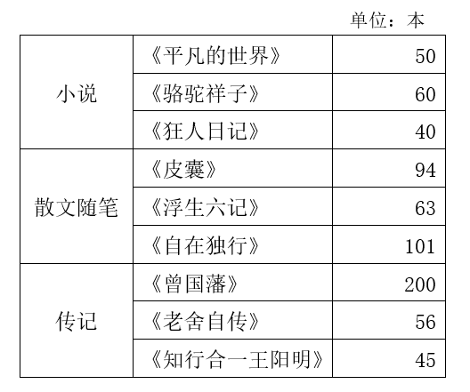
3.7.3 Using hierarchical indexing to retrieve data
Example
How to obtain information about novel classification?
Outer Index
Inner index

Slide 111
3.7.3 Using hierarchical indexing to retrieve data
How to obtain information about
novel classification?
Example
ser_obj = Series ([ 50, 60, 40,
94 , 63, 101, 200, 56, 45 ],
index =[[' novel ', ' novel ', ' novel ',
' Prose Essays ', ' Prose Essays ',
' Prose Essays ', ' Biography ', ' Biography ',
' Biography '], [' Ordinary World ',
' Camel Xiangzi ', ' Diary of a Madman ', ' Skin ',
' Six Records of a Floating Life ', ' Walking Alone ', ' Zeng Guofan ',
' Lao She's Autobiography ', ' The Unity of Knowledge and Action - Wang Yangming ']])
ser_obj [' novel ']
Outer Index
Inner index

Slide 112
3.7.3 Using hierarchical indexing to retrieve data
Example
If you want to know the sales volume of the book " Ordinary World " under the novel category , you can use both the outer index and the inner index at the same time .
ser_obj [' novel ', ' ordinary world ']
If we only know that the name of a book is "Walking alone ", but we don't know the category to which the book belongs, then if we want to know the category and sales volume of the book, we need to obtain it by operating the inner index .
ser_obj [:, ' Walking alone ']
Try demo codes on page 86-87.

Slide 113
3.7.4 Swap the order of index levels
Learning objectives
Understand how to swap the order of index levels, and be able to use the swaplevel () method to swap the order of index levels

Slide 114
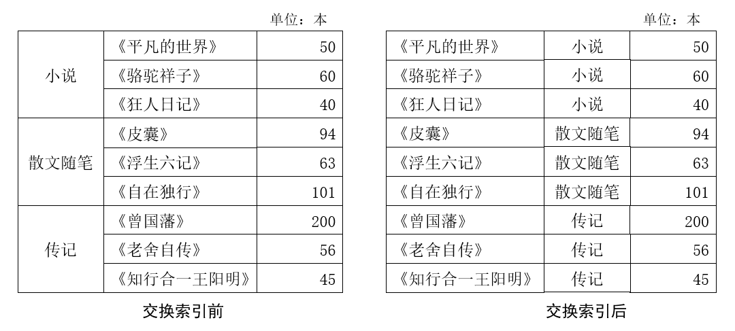
3.7.4 Swap the order of index levels
Concept
Exchanging the order of index levels means exchanging the positions of outer indexes and inner indexes .

Slide 115
3.7.4 Swap the order of index levels
Implementation
In pandas , swapping the order of levels can be done using the swaplevel () method .
ser_obj.swaplevel( )

Slide 116
3.7.5 Hierarchical index sorting
Learning objectives
Master the hierarchical index sorting method and be able to implement the hierarchical index sorting function through

Slide 117
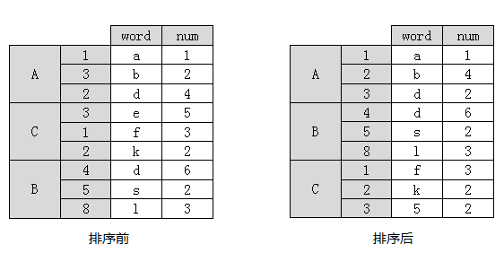
3.7.5 Hierarchical index sorting
If you want to sort an object with a hierarchical index, you can use the sort_index () method to do so. When sorting with the sort_index () method, the outer index is sorted first , and then the inner index is sorted .
Try demo codes on page 87-88.

Slide 118
Case: Statistical analysis of the college entrance examination scores in Shaanxi
3.8

Slide 119
3.8 Case : Statistical analysis of the college entrance examination scores in Shaanxi
In order to help the majority of candidates and parents understand the admission situation of the college entrance examination over the years, some websites have summarized the admission control scores of various provinces and cities . Due to the influence of various factors, the score lines will change more or less every year.

Slide 120

3.8 Case: Statistical analysis of the college entrance examination scores in Shaanxi
This case requires some simple statistical operations on the college entrance examination data from 2008 to 2022 , which are divided into the following three goals :
What is the highest and lowest score line for liberal arts and science in the first and second tier universities, and how much is the difference?
1
Compared with 2021 , how many points have changed in the first liberal arts and science subjects and the second liberal arts and science subjects
2
3
The average score of each subject

Slide 121
Chapter Summary
This chapter mainly introduces the basic knowledge of the data analysis library pandas , including data structure , index and slice operations , reading and writing data , data sorting , arithmetic operations and data alignment , statistical calculation and description , hierarchical index operations , etc. Through the study of this chapter, I hope everyone can master the basic knowledge of pandas .

Slide 122
Assignments
Homework:
Complete the course exercises;
Complete the 9 Pandas practical tasks mentioned in the Report 3 and screenshot your solutions and results

